Slide 1
Lecture 14 Deadlocks
Operating Systems
Notes:
Give qualifications of instructors:
DAP
teaching computer architecture at Berkeley since 1977
Co-athor of textbook used in class
Best known for being one of pioneers of RISC
currently author of article on future of microprocessors in SciAm Sept 1995
RY
took 152 as student, TAed 152,instructor in 152
undergrad and grad work at Berkeley
joined NextGen to design fact 80x86 microprocessors
one of architects of UltraSPARC fastest SPARC mper shipping this Fall

Slide 2
Contents
System Model
Deadlock Characterization
Methods for Handling Deadlocks
Deadlock Prevention
Deadlock Avoidance
Deadlock Detection
Recovery from Deadlock

Slide 3
Deadlocks in the Real World
Yield…
Yield…
DEADLOCK

Slide 4
The Deadlock Problem
A set of blocked processes each holding a resource and waiting to acquire a resource held by another process in the set.
Example
System has 2 tape drives.
P₁ and P₂ each hold one tape drive and each needs another one.
Example
semaphores A and B, initialized to 1
P₀ P₁
wait (A); wait(B)
wait (B); wait(A)

Slide 5
Bridge Crossing Example
Traffic only in one direction.
Each section of a bridge can be viewed as a resource.
If a deadlock occurs, it can be resolved if one car backs up (preempt resources and rollback).
Several cars may have to be backed up if a deadlock occurs.
Starvation is possible.

Slide 6


Deadlocks in the Computer World
Word Processor
has exclusive access of
needs
Web browser
needs
has exclusive access of

Slide 7
System Model
Resource types R₁, R₂, . . ., R_{m}
CPU cycles, memory space, I/O devices
Each resource type R_{i} has W_{i} instances.
Each process utilizes a resource as follows:
request
use
release

Slide 8
Deadlock Characterization
Deadlock can arise if four conditions hold simultaneously.
Mutual exclusion: only one process at a time can use a resource.
Hold and wait: a process holding at least one resource is waiting to acquire additional resources held by other processes.
No preemption: a resource can be released only voluntarily by the process holding it, after that process has completed its task.
Circular wait: there exists a set {P₀, P₁, …, P₀} of waiting processes such that P₀ is waiting for a resource that is held by P₁, P₁ is waiting for a resource that is held by P₂, …, P_{n–1} is waiting for a resource that is held by P_{n}, and P_{n} is waiting for a resource that is held by P₀.

Slide 9
Resource-Allocation Graph
A set of vertices V and a set of edges E.
V is partitioned into two types:
P = {P₁, P₂, …, P_{n}}, the set consisting of all the processes in the system.
R = {R₁, R₂, …, R_{m}}, the set consisting of all resource types in the system.
request edge – directed edge P₁ → R_{j}
assignment edge – directed edge R_{j} → P_{i}

Slide 10
Resource-Allocation Graph
Process
Resource Type with 4 instances
P_{i} requests instance of R_{j}
P_{i} is holding an instance of R_{j}
P_{i}
R_{j}
P_{i}
R_{j}

Slide 11
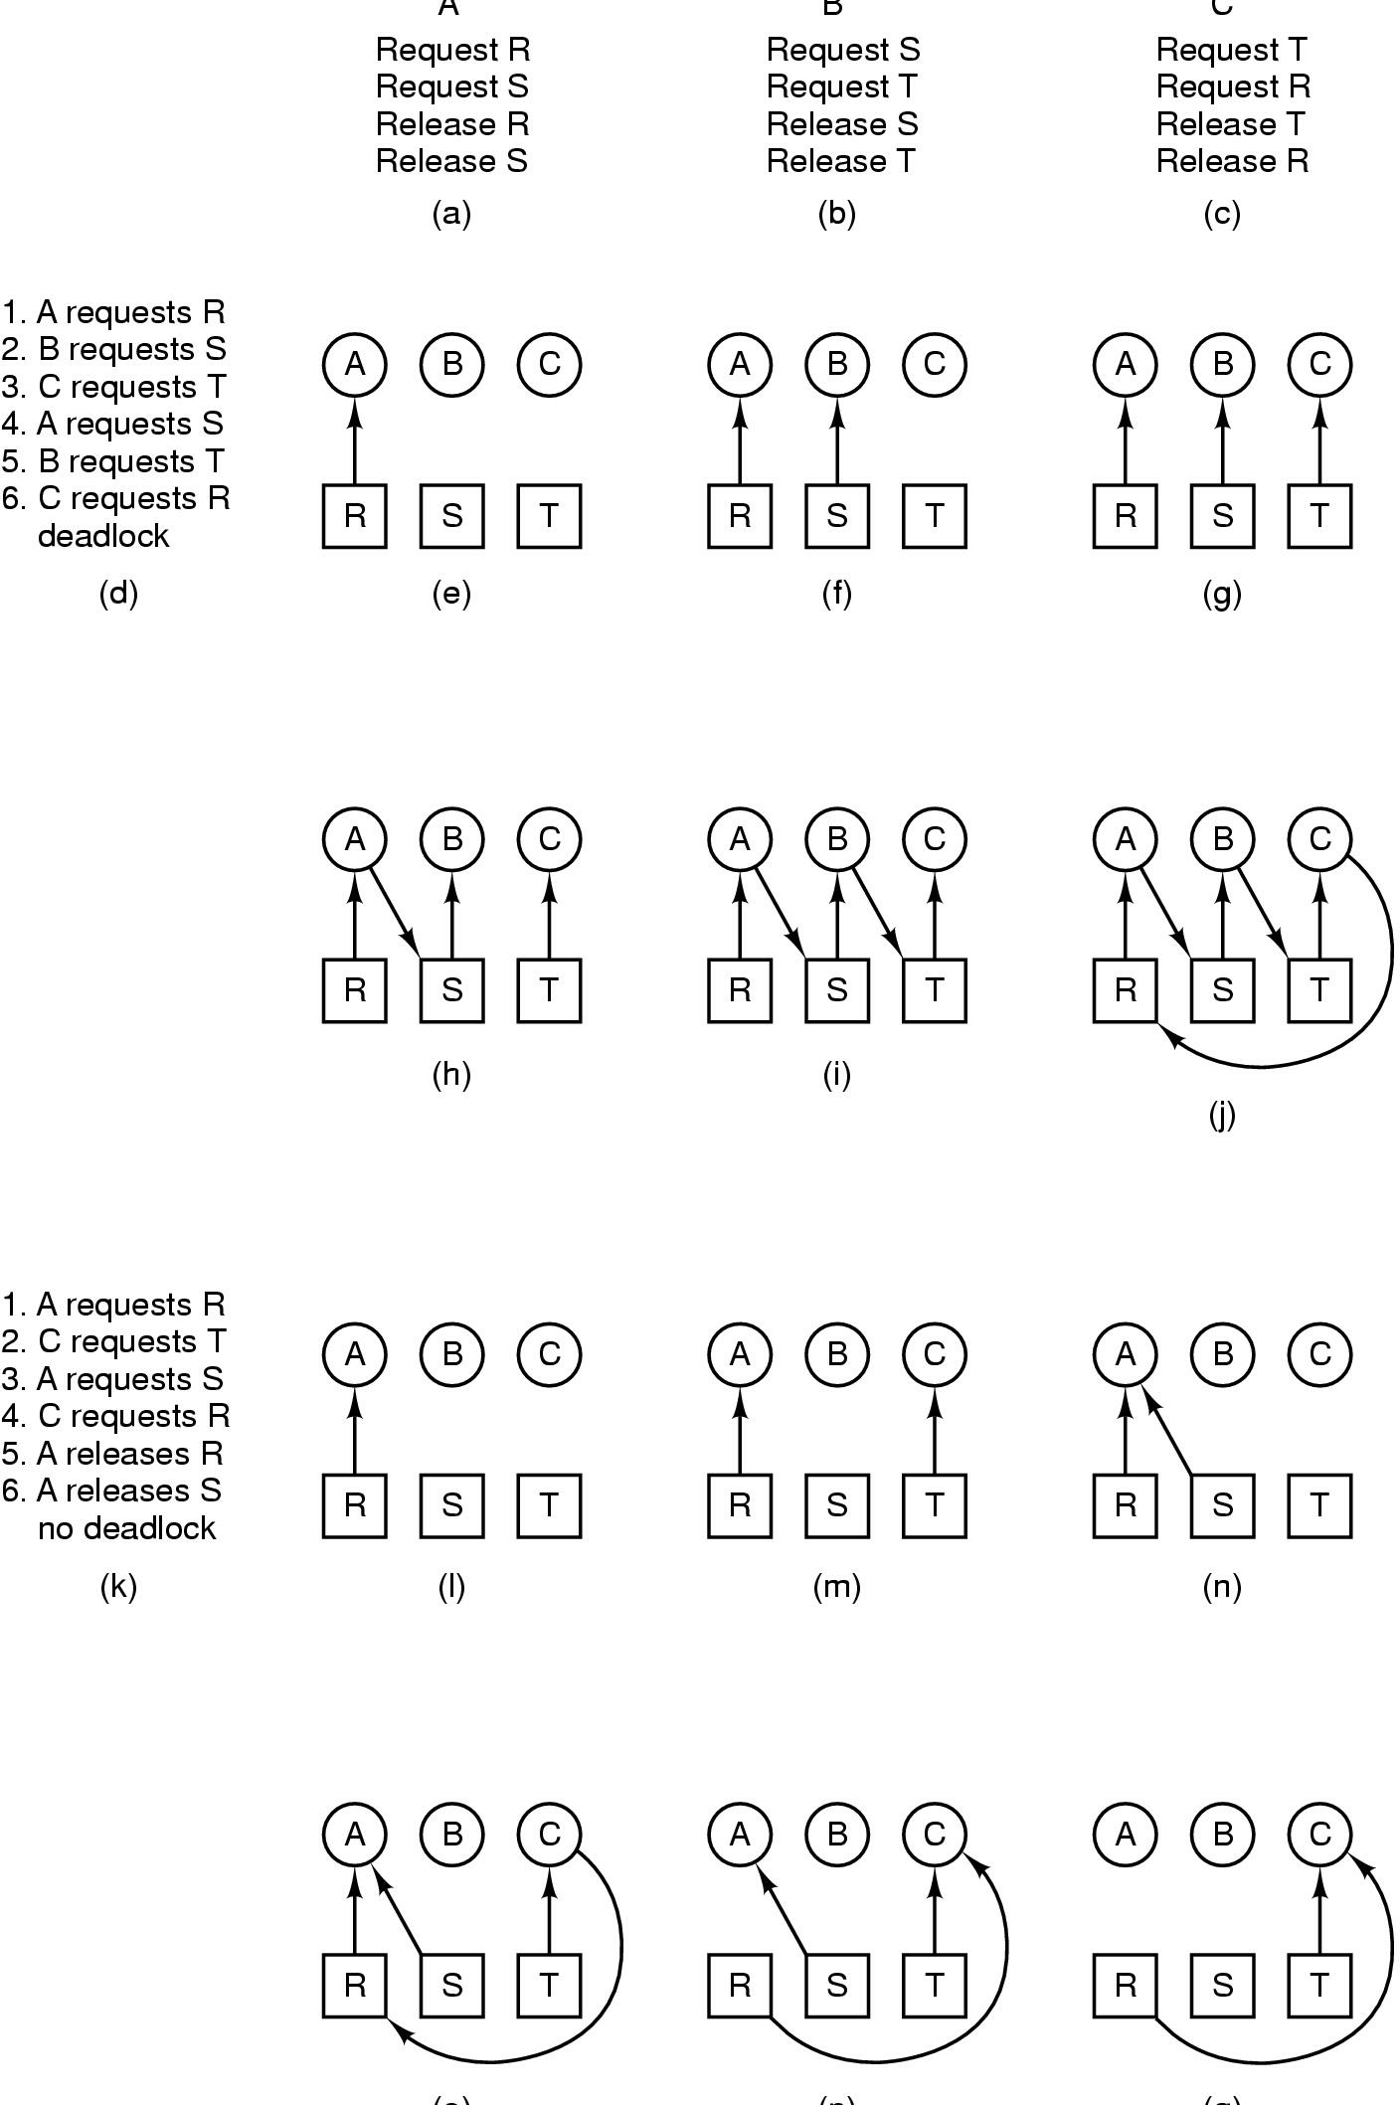
Example
A
B
C
A
B
C
R
S
T
DEADLOCK

Slide 12
Example
A
B
C
A
B
C
R
S
T
NO DEADLOCK

Slide 13
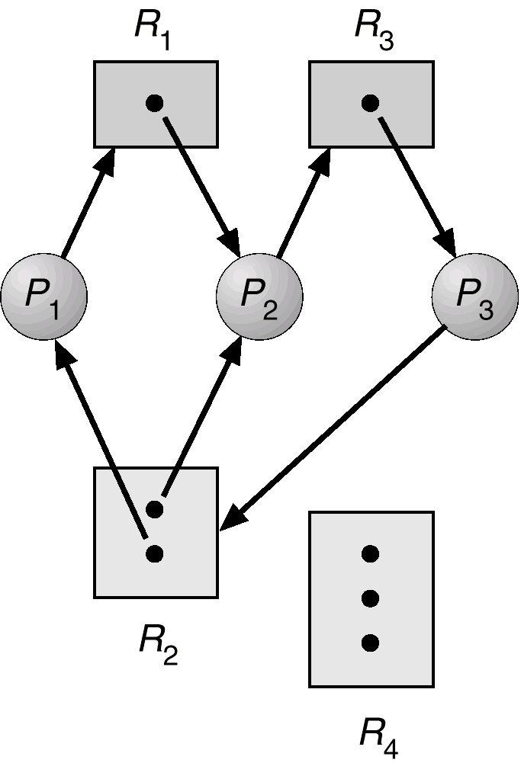
With A Deadlock

Slide 14
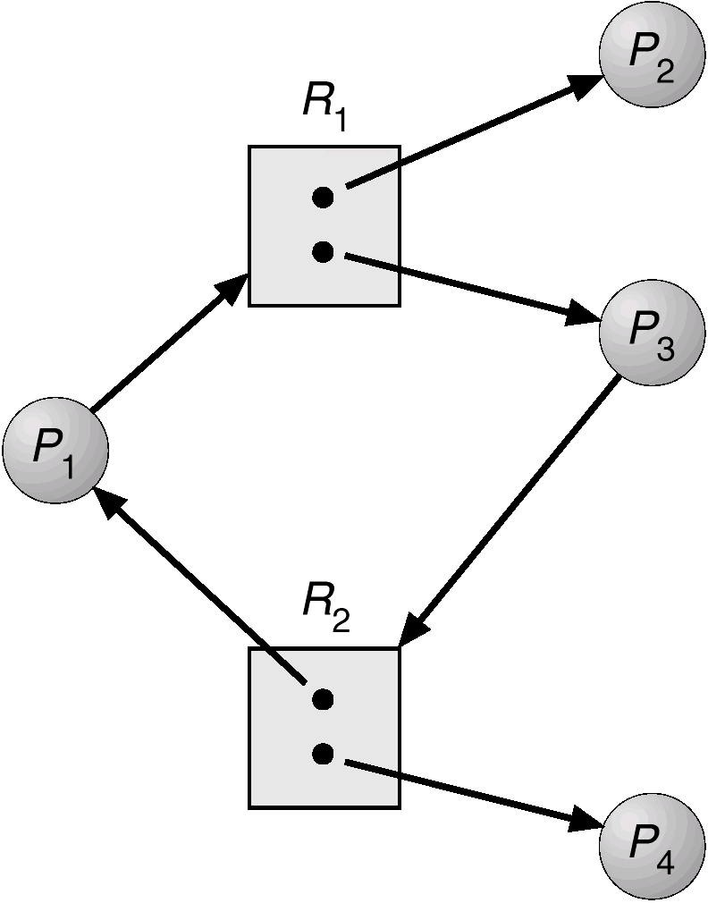
Cycle But No Deadlock

Slide 15
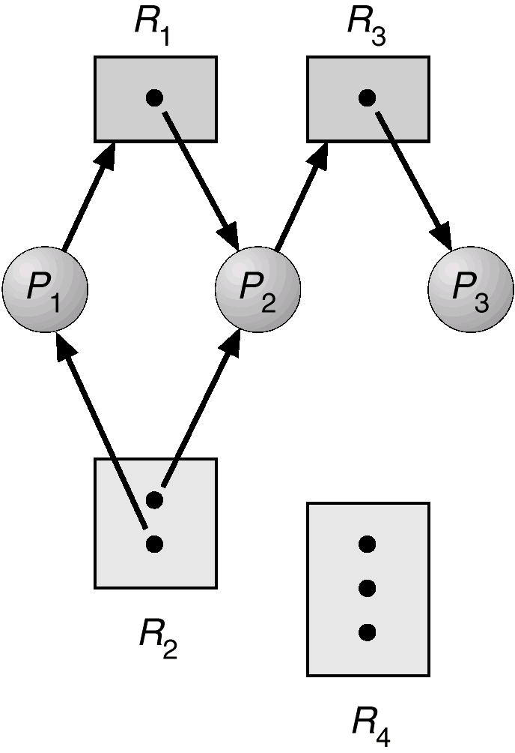
Example of a Resource Allocation Graph

Slide 16
Basic Facts
If graph contains no cycles ⇒ no deadlock.
If graph contains a cycle ⇒
if only one instance per resource type, then deadlock.
if several instances per resource type, possibility of deadlock.

Slide 17
Methods for Handling Deadlocks
Ensure that the system will never enter a deadlock state.
Allow the system to enter a deadlock state and then recover.
Ignore the problem and pretend that deadlocks never occur in the system; used by most operating systems, including UNIX.

Slide 18
Deadlock Prevention
Restrain the ways request can be made.
Mutual Exclusion – if no resource was ever assigned exclusively to a single process, we would never have deadlock.
Hold and Wait – must guarantee that whenever a process requests a resource, it does not hold any other resources.
Require process to request and be allocated all its resources before it begins execution, or allow process to request resources only when the process has none.
Low resource utilization; starvation possible.

Slide 19
Deadlock Prevention
No Preemption –
If a process that is holding some resources requests another resource that cannot be immediately allocated to it, then all resources currently being held are released.
Preempted resources are added to the list of resources for which the process is waiting.
Process will be restarted only when it can regain its old resources, as well as the new ones that it is requesting.
Circular Wait – impose a total ordering of all resource types, and require that each process requests resources in an increasing order of enumeration.

Slide 20
Deadlock Avoidance
Requires that the system has some additional a priori information available.
Simplest and most useful model requires that each process declare the maximum number of resources of each type that it may need.
The deadlock-avoidance algorithm dynamically examines the resource-allocation state to ensure that there can never be a circular-wait condition.
Resource-allocation state is defined by the number of available and allocated resources, and the maximum demands of the processes.

Slide 21
Safe State
When a process requests an available resource, system must decide if immediate allocation leaves the system in a safe state.
System is in safe state if there exists a safe sequence of all processes.
Sequence <P1, P2, …, Pn> is safe if for each Pi, the resources that Pi can still request can be satisfied by currently available resources + resources held by all the Pj, with j<i.
If P_{i} resource needs are not immediately available, then P_{i} can wait until all P_{j} have finished.
When P_{j} is finished, P_{i} can obtain needed resources, execute, return allocated resources, and terminate.
When P_{i} terminates, P_{i+1} can obtain its needed resources, and so on.

Slide 22
Basic Facts
If a system is in safe state ⇒ no deadlocks.
If a system is in unsafe state ⇒ possibility of deadlock.
Avoidance ⇒ ensure that a system will never enter an unsafe state.

Slide 23
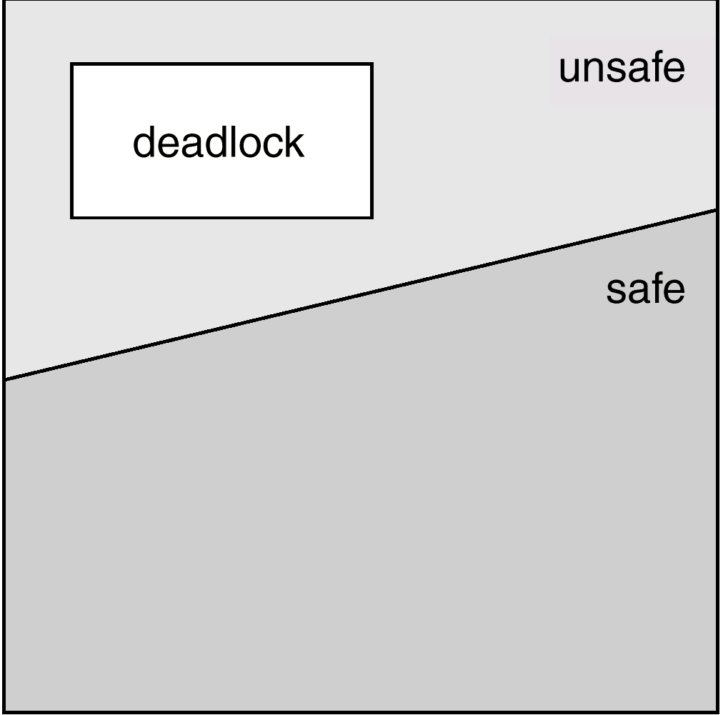
Safe, Unsafe , Deadlock State

Slide 24
Resource-Allocation Graph Algorithm
Claim edge P_{i} → R_{j} indicated that process P_{j} may request resource R_{j}; represented by a dashed line.
Claim edge converts to request edge when a process requests a resource.
When a resource is released by a process, assignment edge reconverts to a claim edge.
Resources must be claimed a priori in the system.

Slide 25
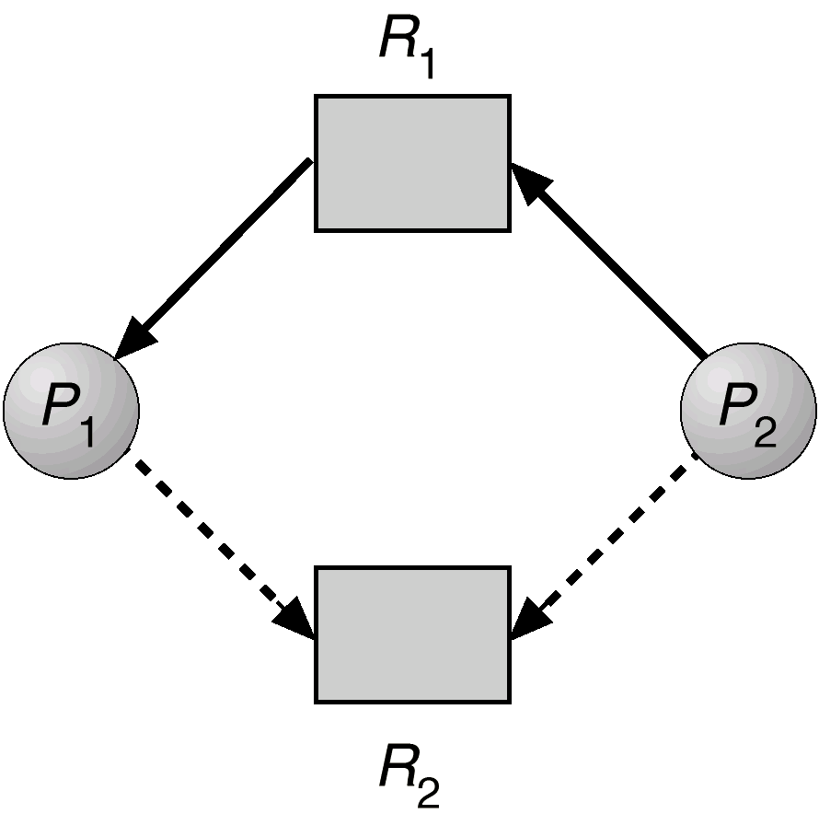
Resource-Allocation Graph For Deadlock Avoidance

Slide 26
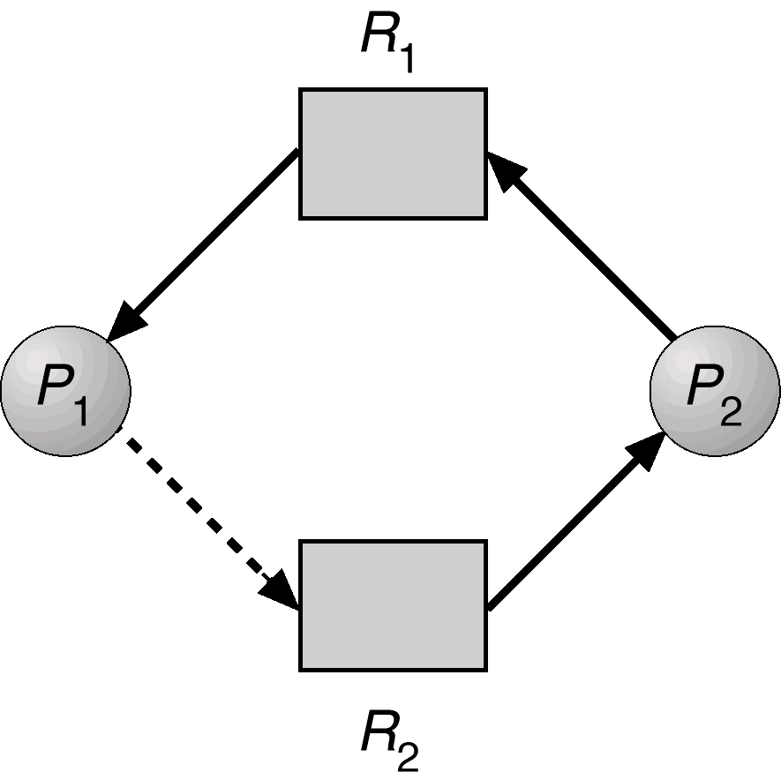
Unsafe State In Resource-Allocation Graph

Slide 27
Banker’s Algorithm
Multiple instances.
Each process must a priori claim maximum use.
When a process requests a resource it may have to wait.
When a process gets all its resources it must return them in a finite amount of time.

Slide 28
Data Structures for the Banker’s Algorithm
Let n = number of processes, and m = number of resources types.
Available: Vector of length m. If available [j] = k, there are k instances of resource type R_{j} available.
Max: n x m matrix. If Max [i,j] = k, then process P_{i} may request at most k instances of resource type R_{j}.
Allocation: n x m matrix. If Allocation[i,j] = k then P_{i} is currently allocated k instances of R_{j.}
Need: n x m matrix. If Need[i,j] = k, then P_{i} may need k more instances of R_{j} to complete its task.
Need [i,j] = Max[i,j] – Allocation [i,j].

Slide 29
Resource-Request Algorithm for Process P_{i}
Request = request vector for process P_{i}.
If Request_{i} [j] = k then process P_{i} wants k instances of
resource type R_{j.}
1. If Request_{i} ≤ Need_{i} go to step 2. Otherwise, raise error condition, since process has exceeded its maximum claim.
2. If Request_{i} ≤ Available, go to step 3. Otherwise P_{i} must wait, since resources are not available.
3. Pretend to allocate requested resources to P_{i} by modifying the state as follows:
Available = Available - Request_{i};
Allocation_{i} = Allocation_{i} + Request_{i};
Need_{i} = Need_{i} – Request_{i;;}
If safe ⇒ the resources are allocated to P_{i}.
If unsafe ⇒ P_{i} must wait, and the old resource-allocation state is restored

Slide 30
Example of Banker’s Algorithm
5 processes P₀ through P₄; 3 resource types A (10 instances), B (5 instances) and C (7 instances).
Snapshot at time T₀:
Allocation Max Available Need
A B C A B C A B C
P₀ 0 1 0 7 5 3 3 3 2
P₁ 2 0 0 3 2 2
P₂ 3 0 2 9 0 2
P₃ 2 1 1 2 2 2
P₄ 0 0 2 4 3 3

Slide 31
Example (Cont.)
The content of the matrix. Need is defined to be:
Max – Allocation.
Need
A B C
P₀ 7 4 3
P₁ 1 2 2
P₂ 6 0 0
P₃ 0 1 1
P₄ 4 3 1
The system is in a safe state since the sequence < P₁, P₃, P₄, P₂, P₀> satisfies safety criteria.

Slide 32
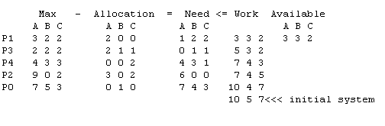
Example
Using the previous example, P1,P3,P4,P2,P0 satisfies criteria.

Slide 33
Example P₁ Request (1,0,2) (Cont.)
Check that Request ≤ Available, that is, (1,0,2) ≤ (3,3,2) ⇒ true.
Allocation Need Available
A B C A B C A B C
P₀ 0 1 0 7 4 3 2 3 0
P₁ 3 0 2 0 2 0
P₂ 3 0 1 6 0 0
P₃ 2 1 1 0 1 1
P₄ 0 0 2 4 3 1
Executing safety algorithm shows that sequence <P1, P3, P4, P0, P2> satisfies safety requirement.
Can request for (3,3,0) by P4 be granted?
Can request for (0,2,0) by P0 be granted?

Slide 34
Deadlock Detection
Allow system to enter deadlock state
Detection algorithm
Recovery scheme

Slide 35
Single Instance of Each Resource Type
Maintain wait-for graph
Nodes are processes.
P_{i} → P_{j} if P_{i} is waiting for P_{j}.
Periodically invoke an algorithm that searches for a cycle in the graph.
An algorithm to detect a cycle in a graph requires an order of n² operations, where n is the number of vertices in the graph.

Slide 36
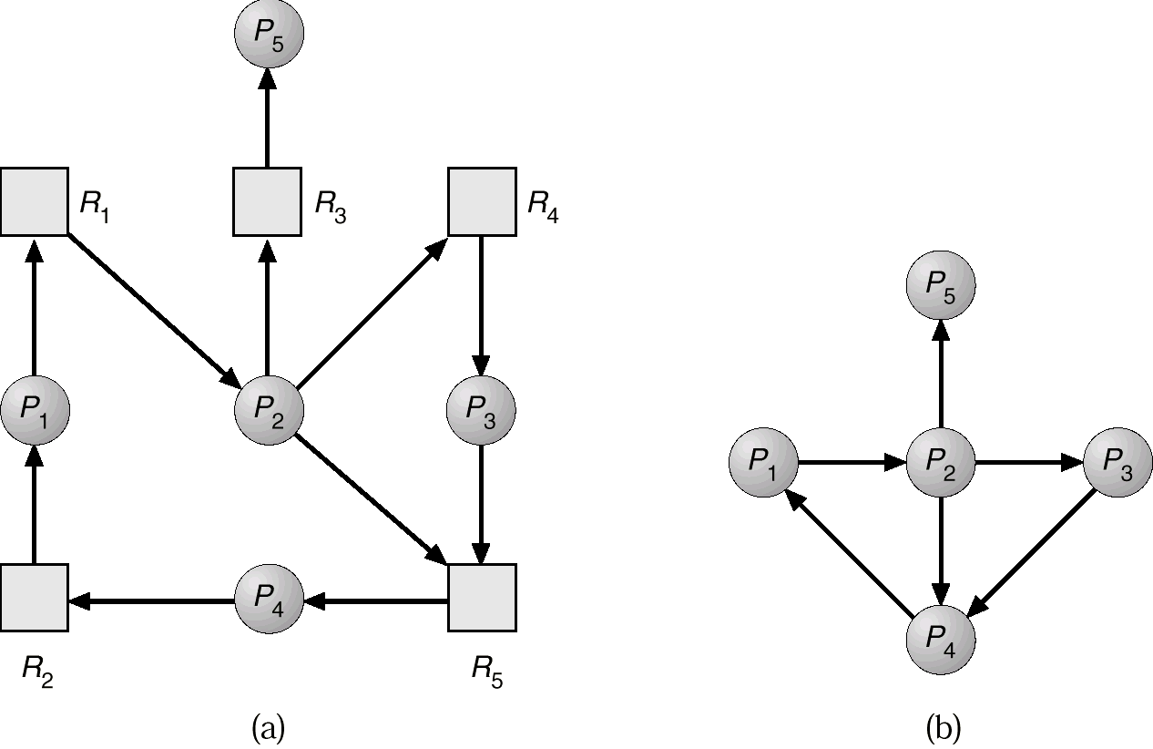
Resource-Allocation Graph and Wait-for Graph
Resource-Allocation Graph
Corresponding wait-for graph

Slide 37
Detection-Algorithm Usage
When, and how often, to invoke depends on:
How often a deadlock is likely to occur?
How many processes will need to be rolled back?
one for each disjoint cycle
If detection algorithm is invoked arbitrarily, there may be many cycles in the resource graph and so we would not be able to tell which of the many deadlocked processes “caused” the deadlock.

Slide 38
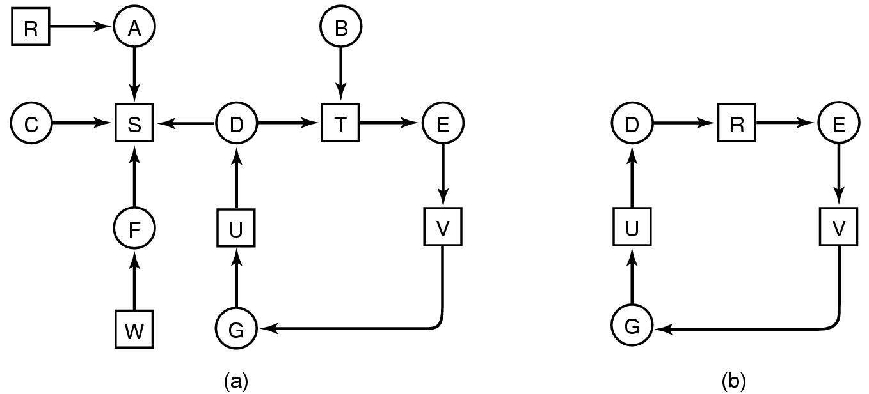
Deadlock Detection
Is there a Deadlock?
Use any cycle detection algorithm
If there’s a cycle there’s a deadlock

Slide 39
Depth First Search
Take each node as root, of what it hopes is a tree
Left to Right, Top to Bottom
R, A, B, C, S, D, T, E, F, U, V, W, G
For each Node
For each outgoing edge
Keep an empty list L
Follow the path and keep adding the nodes to the List L
If the node already exists in the List we have a cycle
Continue till dead end

Slide 40
Depth First Search
R, A, S
A, S
B, T, E, V, G, U, D, S
B, T, E, V, G, U, D, T

Slide 41
Recovery from Deadlock: Process Termination
Abort all deadlocked processes.
Abort one process at a time until the deadlock cycle is eliminated.
In which order should we choose to abort?
Priority of the process.
How long process has computed, and how much longer to completion.
Resources the process has used.
Resources process needs to complete.
How many processes will need to be terminated.
Is process interactive or batch?

Slide 42
Recovery from Deadlock: Resource Preemption
Selecting a victim – minimize cost.
Rollback – return to some safe state, restart process for that state.
Starvation – same process may always be picked as victim, include number of rollback in cost factor.

